Slide 1

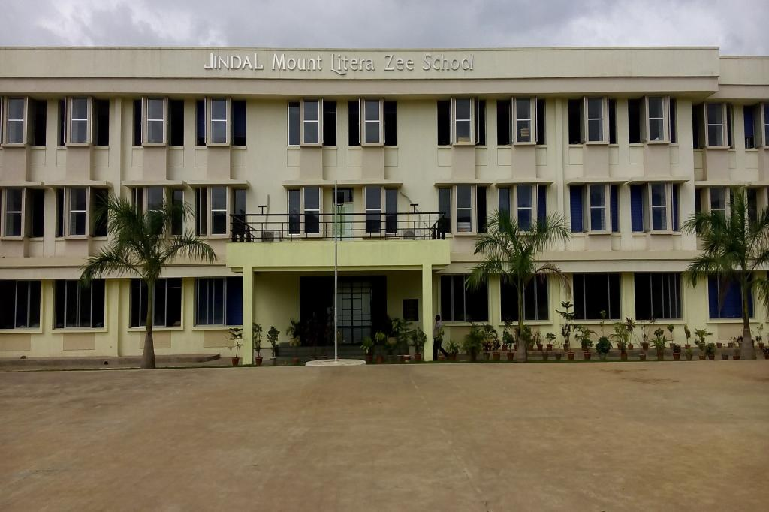
JMLZS Welcomes all Parents to the Orientation Session!!
A Peep into the Academic Session 2023-24

Slide 2


School Vision and Mission
Belief System and Philosophy
3. Meet the Management and Staff
4. USP of the school
Teaching Pedagogies, BLDs, Time Table
Technology Integration In Education
7. Co-Scholastic and Student Engagement Activities
8. School Programmes
Value Inculcation and Skill Development
Assessments
11. List of notebooks
12. Important Committees
13. Safety and Security of Students-
14. Partnering with Parents
15. School Policies
16. Communication Channels
17. Q/A Session

Slide 3

The Vision/Mission of JMLZS
Mount Litera Zee School will provide a complete and unique educational experience for the child, preparing him/her for a successful life in the contemporary society.
The vision of Mount Litera Zee School envisages:
To create an excellent educational institution synthesizing the human values with the highest quality of teaching–learning using modern technology-driven tools for preparing a well-rounded personality for our society.
To make children aware of the significance of an eco-friendly environment.
To nurture the unique potential in each child.
© Jindal Mount Litera Zee School, Sukeli.

Slide 4
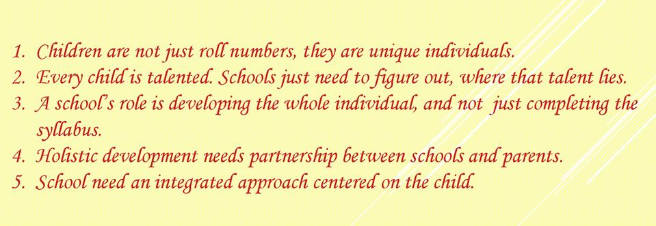
Our belief system
© Jindal Mount Litera Zee School, Sukeli.

Slide 5
Our Philosophy
We help students achieve the Emerging Student Profile (ESP) we identified
We nurture the unique potential of children
We do what is right for the child (WRFC)
Notes:
Trainer Notes
Every aspect, action and decision at Mount Litera Zee School is governed by a single, simple principle –
“What’s Right For the Child (WRFC)”.
This helps us keep the child at the centre of the everything we do and ensures single-minded devotion to their growth and development.

Slide 6
Let’s
Introduce you to
The
Management
Committee
© Jindal Mount Litera Zee School, Sukeli.

Slide 7
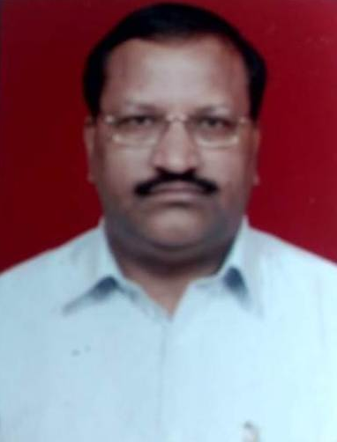
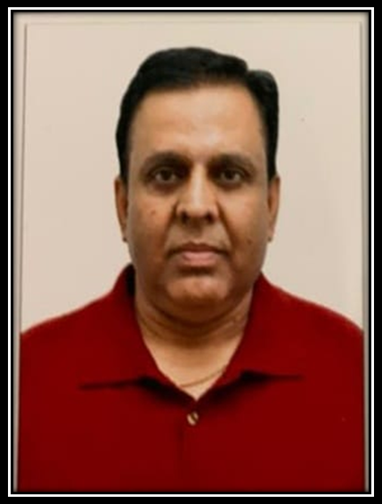
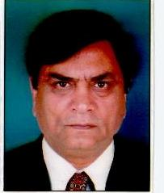
School Management committee members
Chairman
Mr. Vijay Kaushik
Member
Mr. Shiv kumar Singhal
Member
Mr. Sanjeev Banerjee
© Jindal Mount Litera Zee School, Sukeli.
Notes:
Jinda

Slide 8
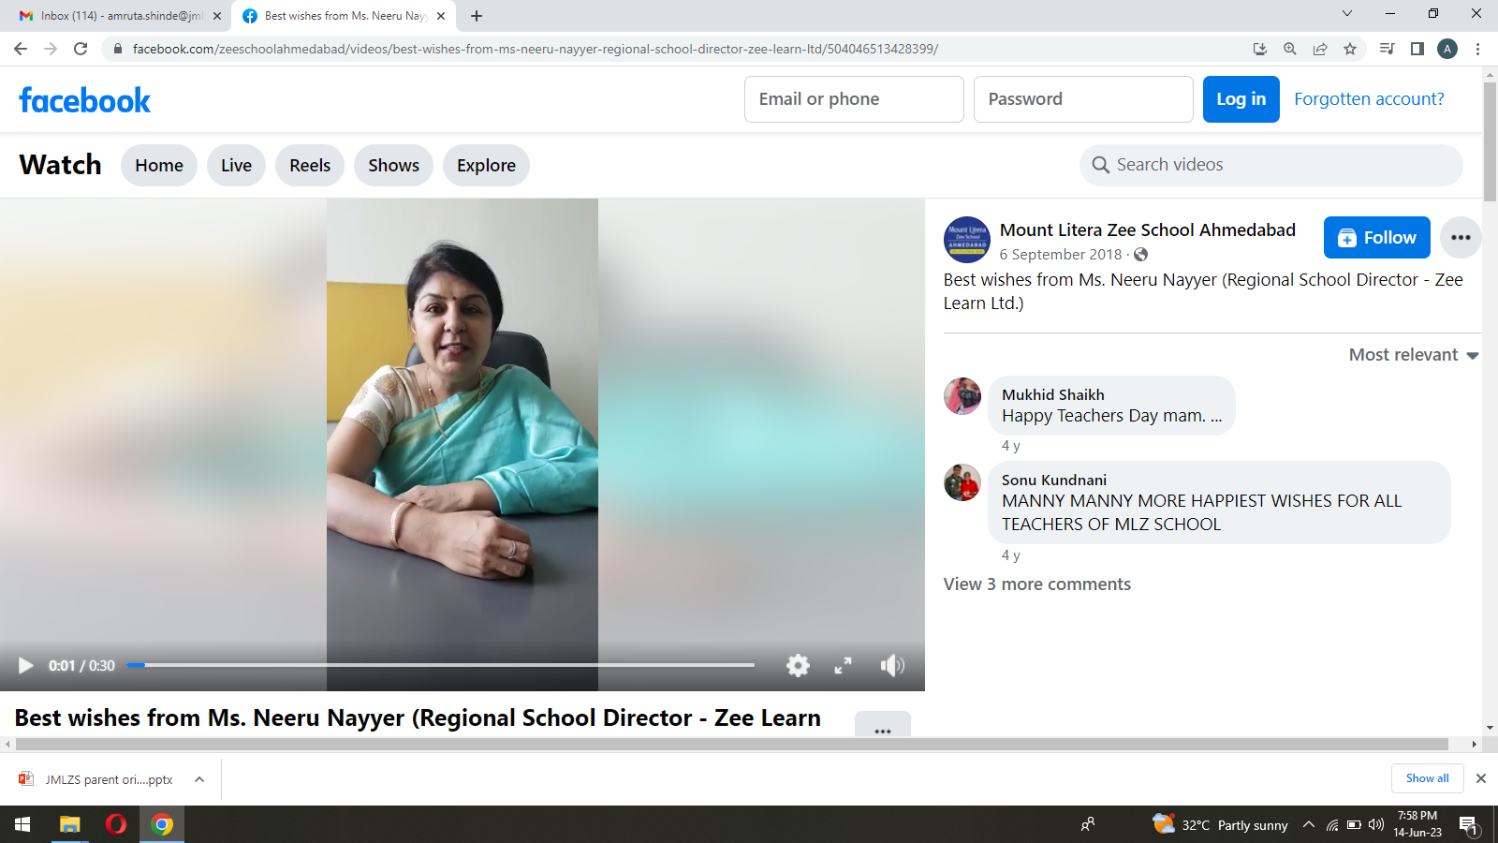
Our Mentor
Ms. – NEERU NAYYAR
Regional School Director Zee Learn
E-mail :- neeru.nayyar@zeelearn.com
© Jindal Mount Litera Zee School, Sukeli.

Slide 9
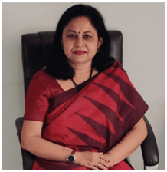
LEADER
Ms. LILY ROY
PRINCIPAL
E-mail :-lily.roy@jmlzsnagothane.in
© Jindal Mount Litera Zee School, Sukeli.

Slide 10
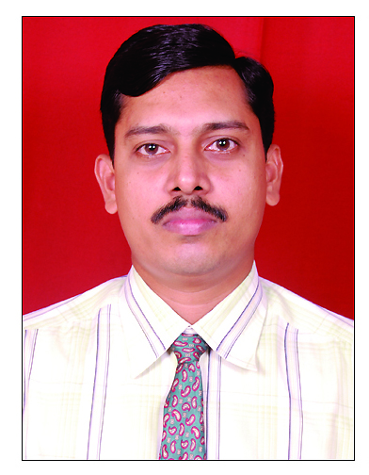
Our Admin Head
Admin Officer
Ph. No. :9867254986
E-mail :- sunil.nayar@jmlzsnagothane.in
© Jindal Mount Litera Zee School, Sukeli.

Slide 11
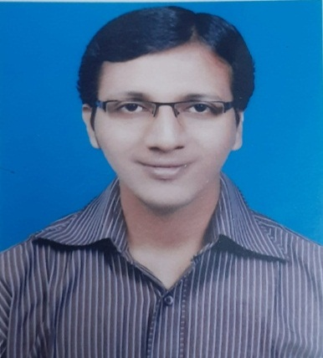
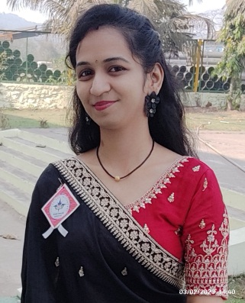
Relationship Manager
Ms.Prajakta Bamane
EmailID:prajakta.bamane@jmlzsnagothane.in
Admin Assistant
Mr.Paresh Patil
Email ID:-paresh.patil@jmlzsnagothane.in
16

Slide 12
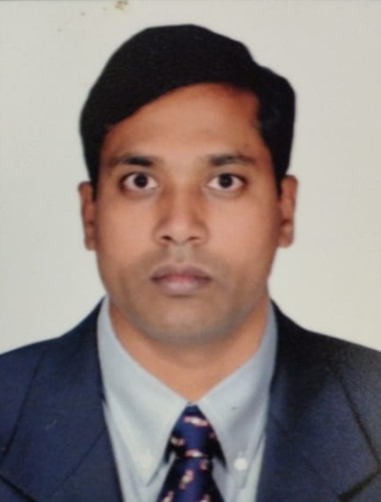
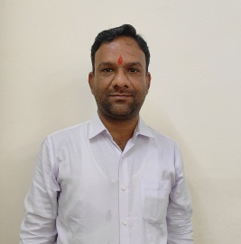
Mr. Kamala Shankar
Ph. No. : 9145722931
E-mail :- kamala.sing@jmlzsnagothane.in
Mr. Mahendra Nandan
Ph. No. :9145722931
E-mail :-accounts@jmlzsnagothane.in

Slide 13
COORDINATORS
Sr. Secondary Section(Grade 9 to 12)- Ms. Manisha Dubey
Secondary Section (Grade 6 to 8)- Ms. Radha Mishra
Primary Section (Grade 3 to 5) – Ms. Rashmi Saxena
Primary Section (Grade 1 & 2) – Ms. Amruta Shinde

Slide 14

Address by Principal
Ms.Lily Roy

Slide 15
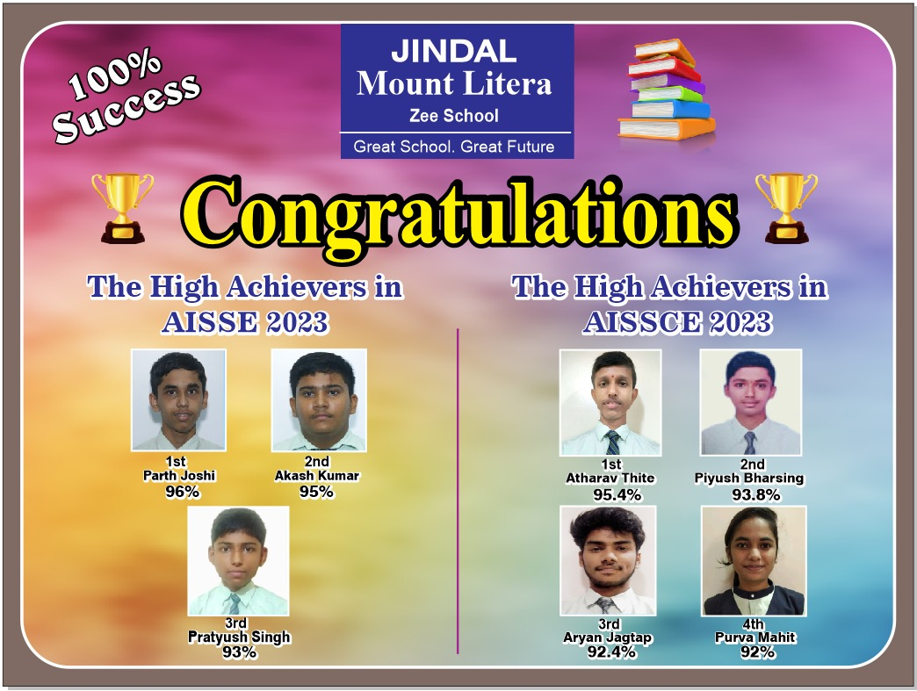
OUR ACHIEVIEVEMENTS

Slide 16
Subject | Name | Percentage
English | Arjavi Sawant | 98
 | Diya Bhatikare | 97
 | Maha Arif Pathan | 97
Hindi | Akash Kumar | 95
 | Anjali Kumari | 95
 | Ankush Ambhore | 95
Math | Parth Joshi | 98
 | Pratyush Singh | 98
 | Akash Kumar | 95
Science | Akash Kumar | 95
 | Parth Joshi | 95
 | Pratyush Singh | 95
SST | Akash Kumar | 97
 | Aditya Kadam | 95
 | Parth Joshi | 95
IT | Parth Joshi | 98
 | Akash Kumar | 91
 | Sanyan Jain | 90
Result Analysis for Class X

Slide 17
CBSE CLASS XRESULT
CBSE CLASS X RESULT
Total students appeared | 56
Total students passed | 56
Result | 100%
RANK HOLDERS
1. Parth Joshi | 96%
2. Akash Kumar | 95%
3. Pratyush Singh | 93%

Slide 18
Subject | Name | Percentage
English | Aryan Jagtap | 97
 | Smriti Kumari | 97
 | Purva Mahit | 96
 | Sneha Jha | 96
Physics | Atharva Thite | 95
 | Aryan Jagtap | 94
 | Piyush Bharshing | 94
 | Sooraj Mohan | 94
Chemistry | Aryan Jagtap | 95
 | Atharva Thite | 95
 | Purva Mahit | 95
 | Sooraj Mohan | 94
Math/Biology | Athavale Thite | 95
 | Piyush Bharshing | 92
SST | Sneha Jha | 88
 | Atharva Thite | 99
 | Piyush Bharshing | 97
IT | Aryan Jagtap | 95
 | Purva Mahit | 95
Result Analysis for class XII

Slide 19
CBSE CLASS XII RESULT
Total students appeared | 22
Total students passed | 22
Result | 100%
RANK HOLDERS
1. Athava Thite | 96%
2. Piyush Barshing | 94%
3. Purva Mahit | 92%

Slide 20
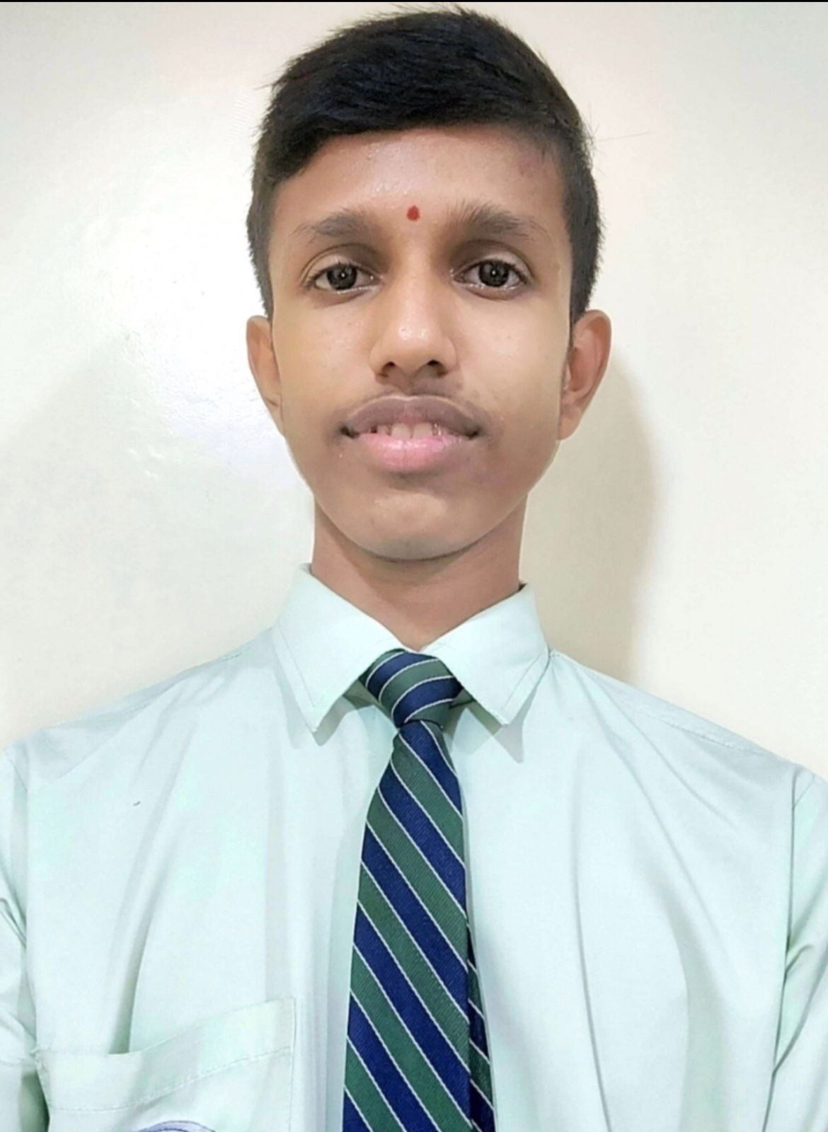
CONGRATULATIONS!!!
Master Atharva Thite of Class XII in MHT-CET 2023-24 for scoring 99.97%

Slide 21
New initiative for enhancing the quality of education at our school
1) Scholastic and Co- Scholastic pursuits:
By including Monday to Friday Scholastic education
Saturday exploring Co-Scholastic education
2) Trying to make our students “ Global citizen “ by practicing reading Newspaper.
3) Career Exploration workshops conducted by Expert Teachers.
4) Introduction of skilled based education
5) Suggestion Box
6) The amalgamation of ancient ( Gurukul Shiksha) and modern education.
7) Donation drive for an Orphanage
8) We will be providing training for teachers, students and parents more frequently.
9) Career Counselling
10) Personalized and tailored career counselling to individual student’s needs
11) Resource person in school.

Slide 22

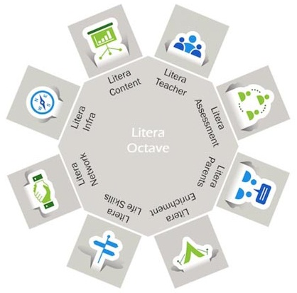
Litera Octave
Unique Child – Centric Teaching Process
Notes:
How do we achieve the - Broad based Learning i.e. CONTENT and Behavioral Outcomes, i.e. ESP?
Through the Litera Octave –
1. Litera Teacher - Equipped with the 13 attributes
2. Litera Assessment - Centrally conducted exams for grade 1 – 10
3. Litera Parent - Seminars, PTM and Workshops to make effective partners
4. Litera Enrichment - Litera Content, Co-curricular and extra-curricular activities
5. Litera Life Skills - Activities that hone the Multiple Intelligences
6. Litera Network - Collaborative Learning within the Network
7. Litera Infra - Classrooms enabled with IWB, Computers, Projectors, Labs, Library,Luminosity
8. Litera Content - Blended Learning Design & Litera Content

Slide 23


Emerging Student Profile
Life Skills Effective Habits Media Literacy Aesthetic Sense Metacognition Risk Taking Self Development Knowledge Higher Order Thinking Skills Sports Art( Fine Arts, Performing Arts) Entrepreneurial and Financial Core Values( Integrity,Open Mindedness,Authenticity,Humility, Growth Mindset, Compassion
Notes:
Trainer Notes
Life Skills
Life Skills are critical for leading life powerfully. Our students emerge out of school with the following life skills. We build life-skills through specially-designed life skills classes, subject-integrated activities, Litera Clubs.
Effective Habits: Our character is a composite of our habits. Mount Litera Zee Schools have a series of programs and activity systems that build effective habits for life.
Media Literacy: Media literacy develops the ability to analyse, critique and effectively use various media to find more information and make informed decisions.
Aesthetic Sense: Aesthetic sense helps students appreciate the beauty that exists around them and enables them to contribute to it.
Metacognition: Metacognition is the skill of knowing how we learn and our unique styles of learning. This empowers us in removing the hidden barriers to our learning.
Risk Taking : This skill enables making your own decisions at the risk of making a mistake, instead of doing what you are told to by others.
Self-Development: An important goal in education is to foster self-reliance and independence. Self-development plans are used for teaching students to complete tasks independently and take an active role in monitoring and reinforcing their own behaviour.
Knowledge
Knowledge, as defined at Mount Litera Zee School, goes beyond the traditional boundaries of academic learning. Our students gain knowledge in the following areas.
Higher-Order Thinking Skills (HOTS) : Students gain real understanding of the subject they take. This enables them to not only retain and apply concepts but also to create new knowledge and ideas from their understanding.
Sports : Students are encouraged to take up sports not only for fitness and health but also to ingrain the values of sportsmanship and teamwork.
Art (Fine Arts, Performing Arts and Applied Arts) : Students develop proficiency in one or more art form.
Entrepreneurship and Financial : Students are encouraged to see the world as an owner. They develop an ability to reach a goal by making choices and planning necessary actions. Students also develop a strong and empowering relationship with money and money management practices.
Core Values
LIFE SKILLS
KNOWLEDGE
CORE VALUES
Core values function as the foundation of leadership. Our students will role model these values. We firmly believe that values cannot be taught in a classroom and that's why we promote an ecosystem that sustains and nurtures these values.
Integrity : Integrity does not only mean being honest. Integrity means being true to oneself and acting in respect of values that one holds. Integrity is displayed in how teachers and students share information, plan and work on assignments, and how the school system handles commitments and decisions.
Open Mindedness : To have an open mind means to be willing to consider or receive new ideas and people with different outlook. It means being flexible, adaptive, and accepting the fact that'others could be right with their differences too'. This value encourages people to seek to understand before expecting to be understood. Cultivating an open mind is another valuable outcome of critical thinking and reasoning; an open mind helps us expand our horizons and be more diverse and inclusive.
Authenticity : It is the alignment of head, mouth, heart, and hands - thinking, saying, feeling, and doing the same thing consistently. This builds trust and sense of cooperation.
Humility : The very basic requirement in a leader because people feel comfortable around a person who pays attention to them and is considerate. Respecting others brings it around to oneself too. Such a person is happier and has more friends. This helps relate to others and their situations and thus deal with them better.
Growth Mindset : Students with a growth mindset believe that their intelligence can be developed over time through their own effort. They know that while not everyone has the same kind of intelligence, everyone can learn and improve. The growth mindset helps children focus on their efforts. They are free to concentrate on becoming smarter rather than looking smart.
Compassion : Inculcating compassion can make our students aware of the world around them and it teaches tolerance towards different cultures and personalities. This enables children to be more sensitive and caring, that in turn leads to better relationships with others as they grow into adulthood.

Slide 24
Blended Learning Designs
Blooms Taxonomy
&
Multiple Intelligences
Outcome Based Learning
Emerging Student Profile
CONCEPTUAL UNDERSTANDING
Competency Based Learning
Experiential Learning
Aligned with LRs
Art and Sports Integration
Collaborative Learning
Notes:
Trainer Notes

Slide 25
Learning Resource
Based on 21stt Century Skills.
Stresses on 4 Cs- Critical Thinking & Problem Solving, Communication, Collaboration, Creativity and Innovation.
Learning Tools | Enrichment Tools- Soar to Explore
Did You Know? Mind Map Study Byte Milestone Test your Vocabulary Timeline | Fun Activity Extended Learning Technology Connection Interdisciplinary Value Based Question Internationalism HOTS Creative Corner Develop your Map Skills
Notes:
Trainer Notes-
Did You Know? – Interesting and amazing facts related to the text
Mind Map- Recap of main text
Study Byte- point wise description of concept/ sub concept
Milestone- gauges learner’s progress in understanding of the concept
Test your Vocabulary- concept related vocabulary
Timeline- chronology of events
Fun Activity- Enjoyable and engaging learning
Extended Learning- learning beyond the text
Technology Connection- use of technology to assimilate the ideas
Interdisciplinary- holistic learning through connecting the concept with other scholastic subjects
Value Based Question- inculcation of values
Internationalism- views the concept in a global perspective
HOTS- to develop critical thinking and problem solving skills
Creative Corner- develop psychomotor skills and enhances creativity
Develop your Map Skills

Slide 26
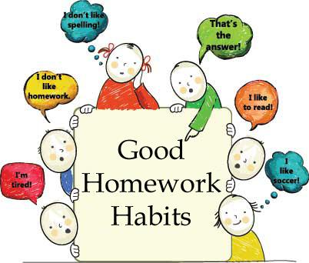
Home work and Assignments

Slide 27
JINDAL MOUNT LITERA ZEE SCHOOL
SCHOOL TIMINGS
Offline classes will be conducted from 9:00 a.m. to 3:10 p.m. as per schedule
PERIOD | TIMING | DURATION
Assembly | 9:15 a.m. to 9:35 a.m. | 20 mins
1 | 9:35 a.m. to 10:10 a.m. | 35 mins
2 | 10:10 a.m. to 10:45 a.m. | 35 mins
3 | 10:45 a.m. to 11:20 a.m. | 35mins
Long Break | 11:20 a.m. to 11:45 a.m. | 25 mins
4 | 11:45 a.m. to 12:20 p.m. | 40mins
5 | 12:20 p.m. to 12:55 p.m. | 35 mins
6 | 01:55 p.m. to 01:30 p.m. | 35mins
Short Break | 01:30 p.m. to 01:40 p.m. | 10 mins
7 | 01:40 p.m. to 02:15 p.m. | 35mins
8 | 02:15 p.m. to 03:10 p.m. | 55 mins

Slide 28

Notes:
Trainer Notes-
Did You Know? – Interesting and amazing facts related to the text
Mind Map- Recap of main text
Study Byte- point wise description of concept/ sub concept
Milestone- gauges learner’s progress in understanding of the concept
Test your Vocabulary- concept related vocabulary
Timeline- chronology of events
Fun Activity- Enjoyable and engaging learning
Extended Learning- learning beyond the text
Technology Connection- use of technology to assimilate the ideas
Interdisciplinary- holistic learning through connecting the concept with other scholastic subjects
Value Based Question- inculcation of values
Internationalism- views the concept in a global perspective
HOTS- to develop critical thinking and problem solving skills
Creative Corner- develop psychomotor skills and enhances creativity
Develop your Map Skills

Slide 29
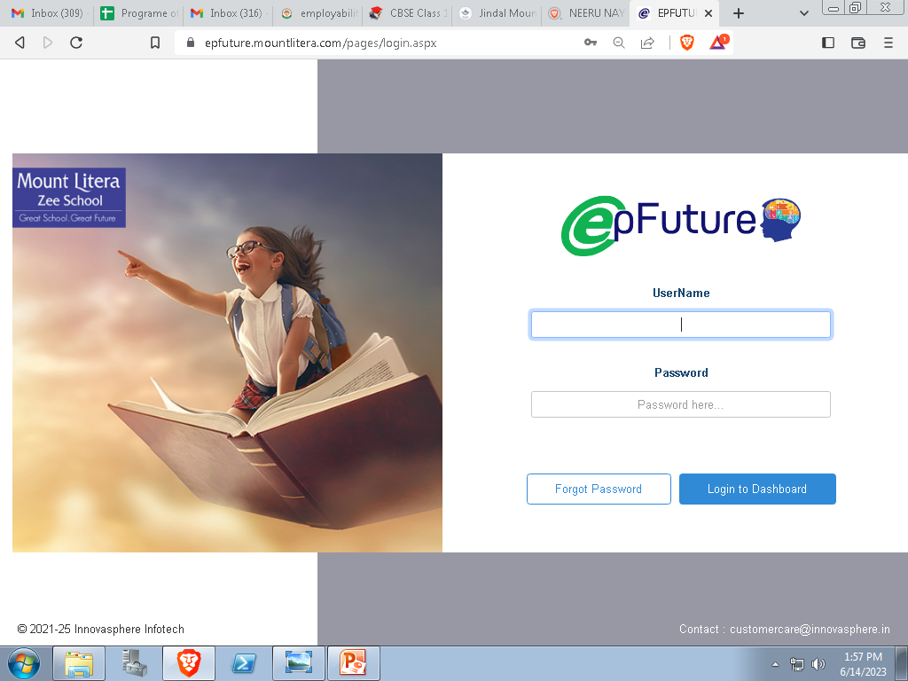
Ep future

Slide 30
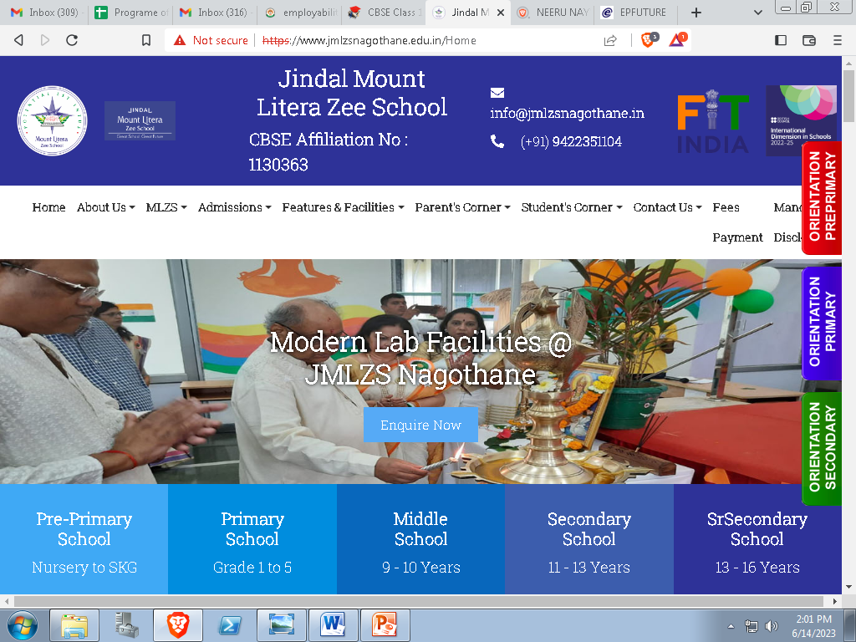

Slide 31
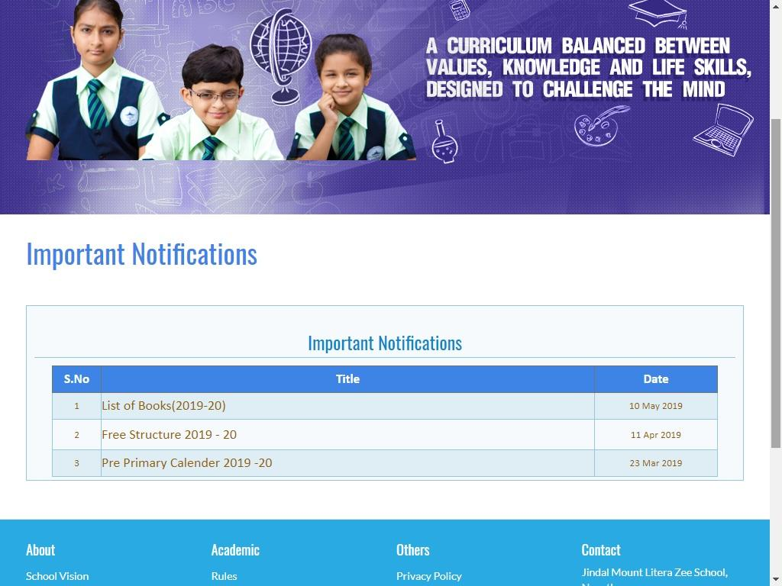

Slide 32
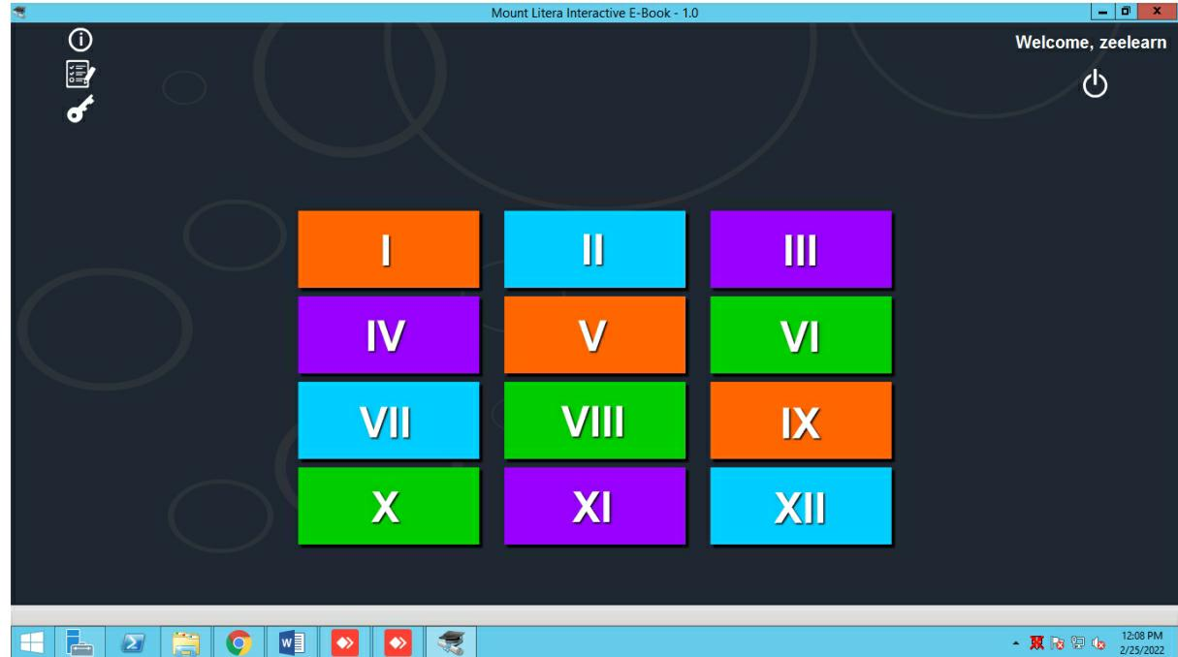

Slide 33
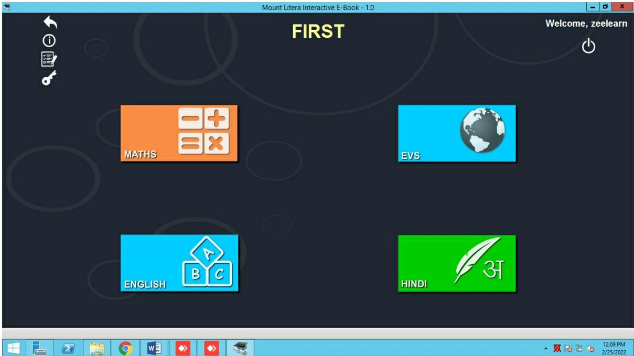

Slide 34
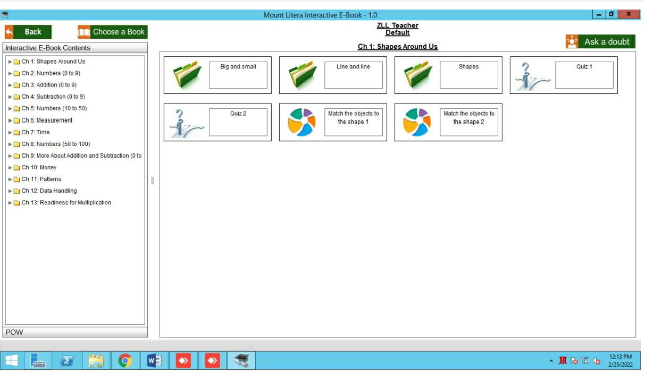

Slide 35


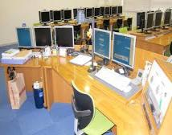





INFRASTRUCTURE
Specials In JMLZS
Library
Art room
Dance room
Computer room
Classrooms with IWB
Language Lab
Science Labs
Sport room
Math Lab
Ground
Auditorium
Conference room

Slide 36
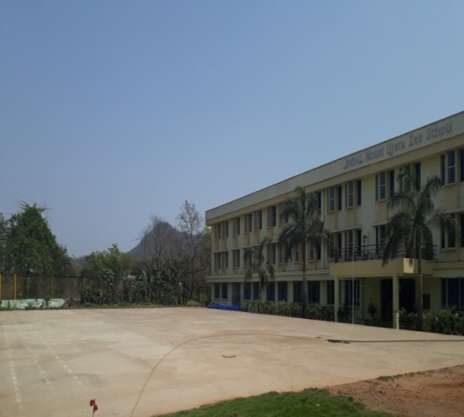
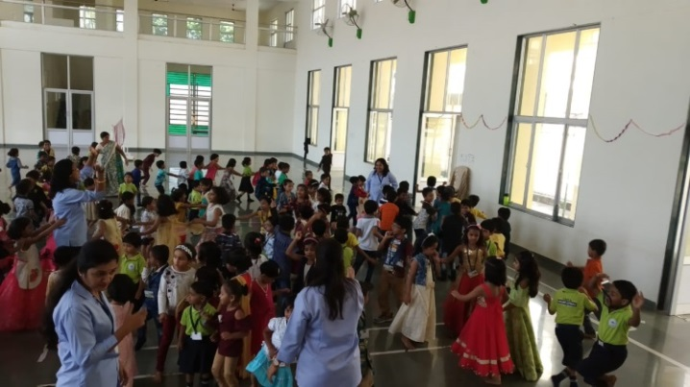
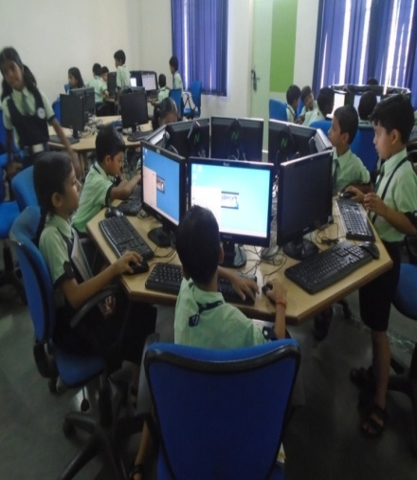
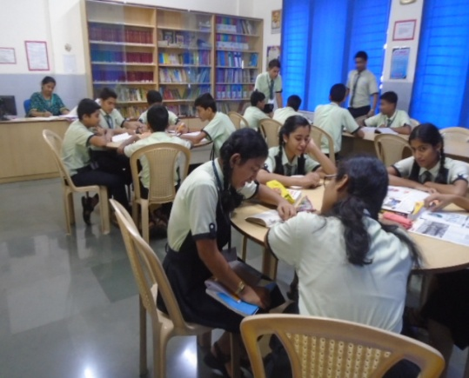
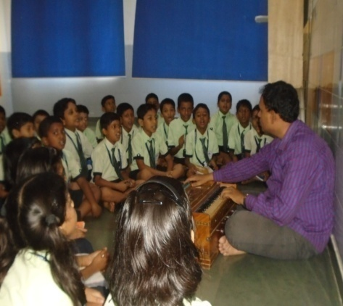
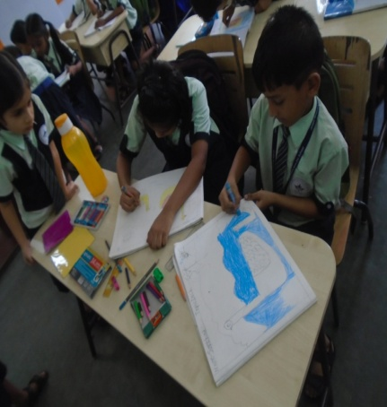
Playground
Auditorium
Computer Lab
Library
Music Room
Art Room

Slide 37
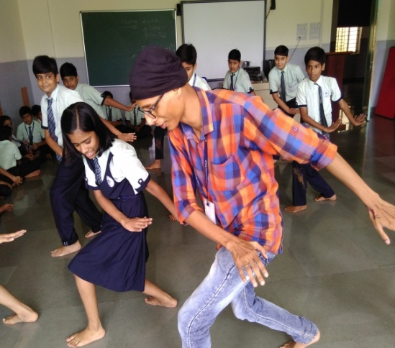
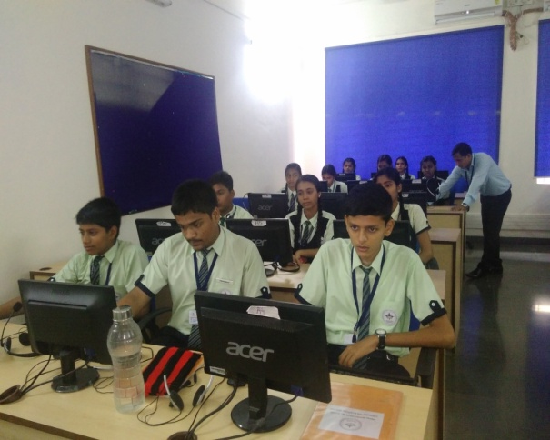
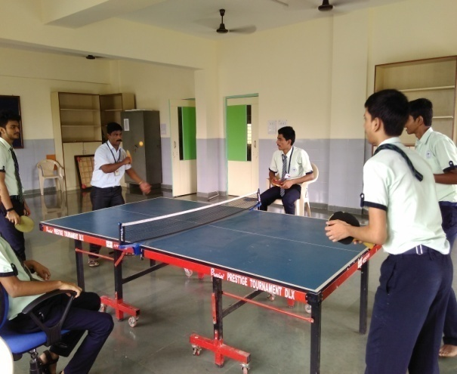
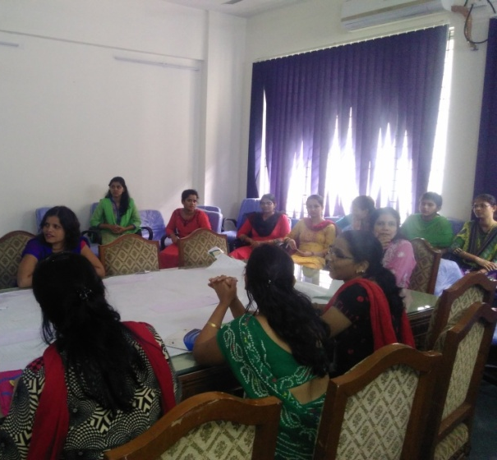
Dance Room
Language Lab
Sports Room
Conference Room

Slide 38
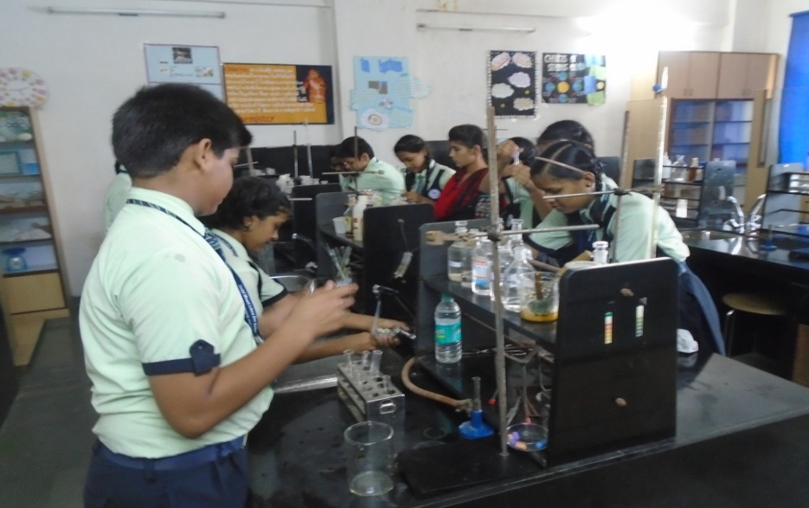
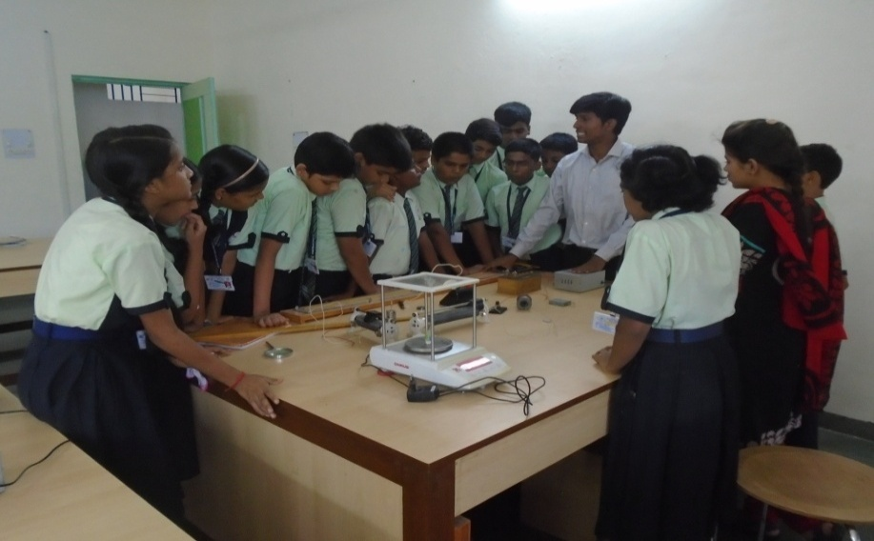
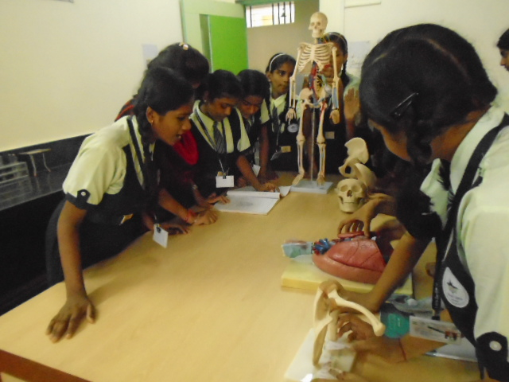
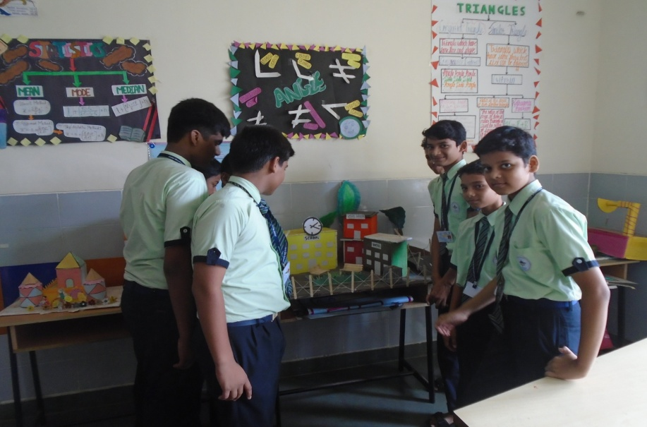
CHEMISTRY LAB
PHYSICS LAB
BIOLOGY LAB
MATH LAB

Slide 39
Co-scholastic activities
Students are expected to participate in all school activities unless excused by the appropriate head on a written request from the parent / guardian.
Activities are as follows:
Monthly theme based activity
Art & craft
Music
Dance
Sports
MLZS Vihang

Slide 40
Annual Academic Calendar
2023-24
http://www.jmlzsnagothane.edu.in/Calendar

Slide 41
Activities undertaken by the school
International Dimension In School
Digital Citizenship Program
Science/English/Math/cyber Olympiad Foundation
Vihaang Activity

Slide 42
INTERNATIONAL DIMENSION IN SCHOOL
IDS was introduced in India in the year 2003 and nearly 1300 schools across the country have joined this exciting journey since then.
International Dimension in Schools celebrates a school's effort to include international work as part of their curriculum and helps embeded it within the school's culture. The programme supports schools in fostering an international ethos throughout the school and embedding it within the curriculum Various Collaborative and Inhouse activities were conducted to promote international topics of education.

Slide 43
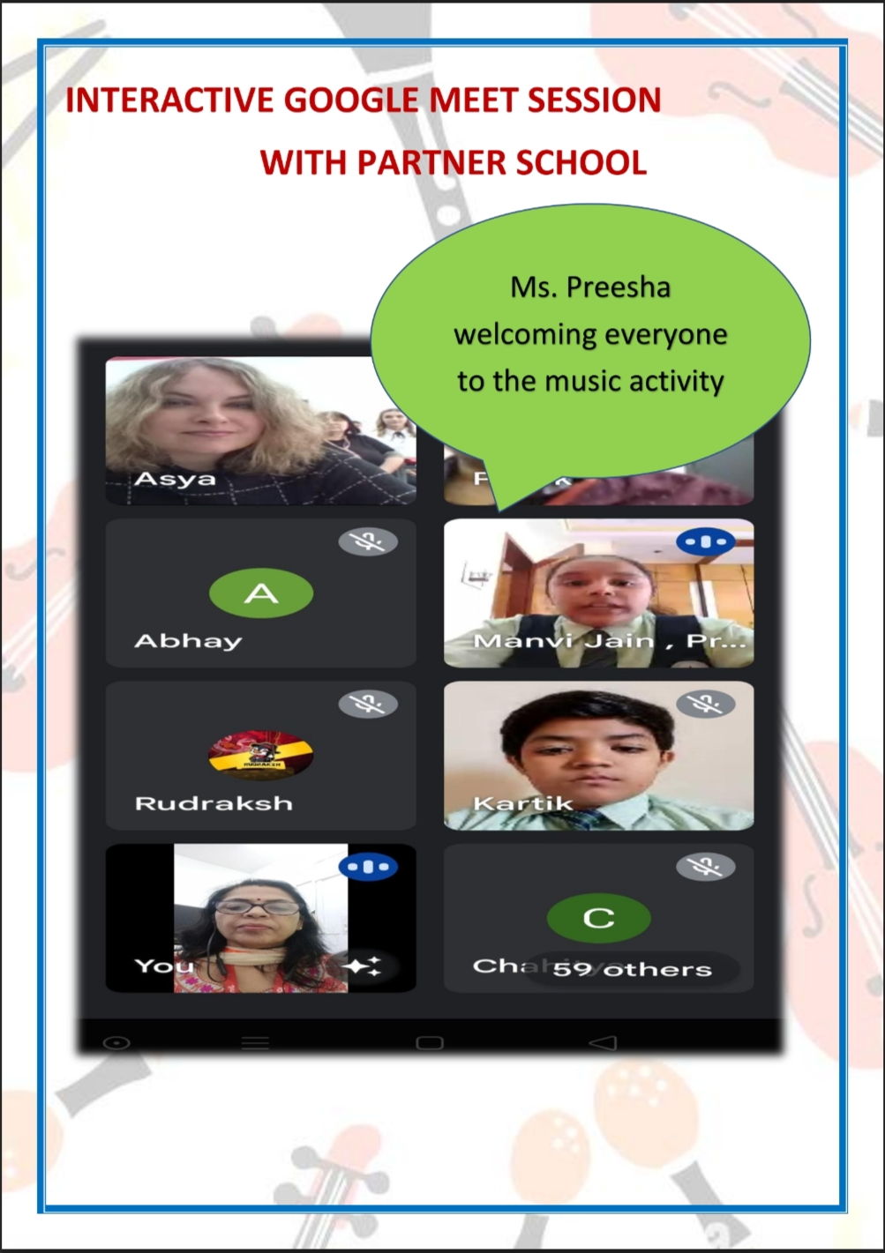
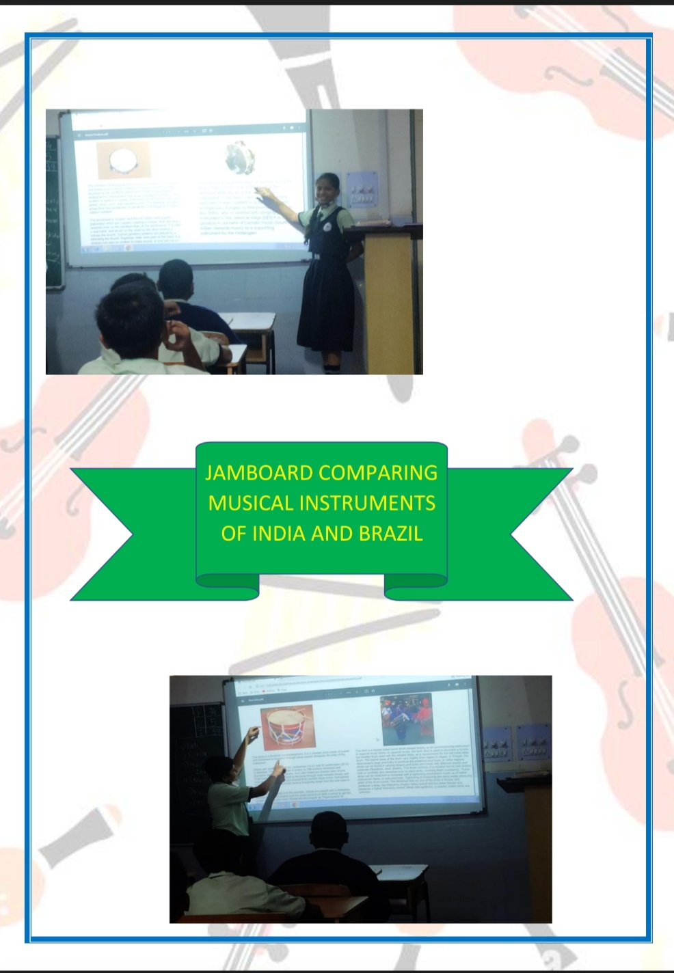

Slide 44
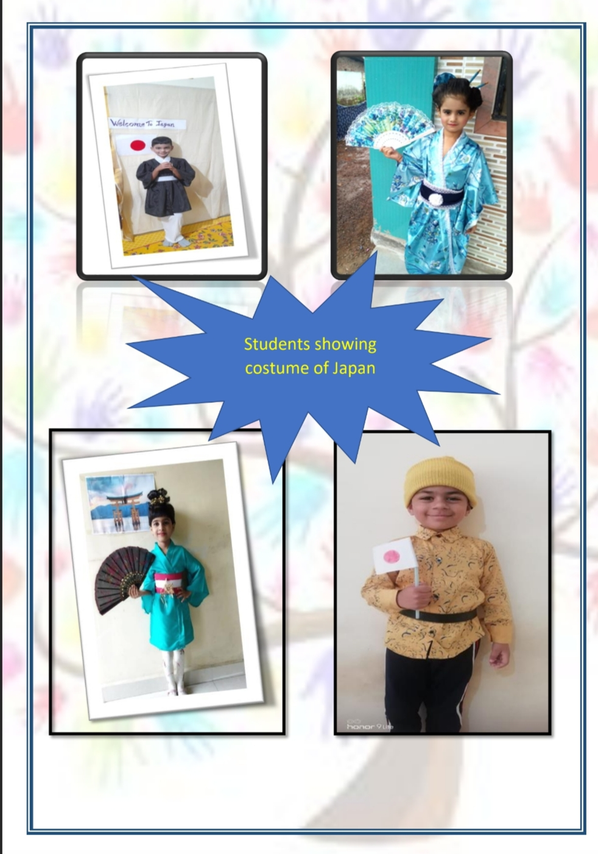
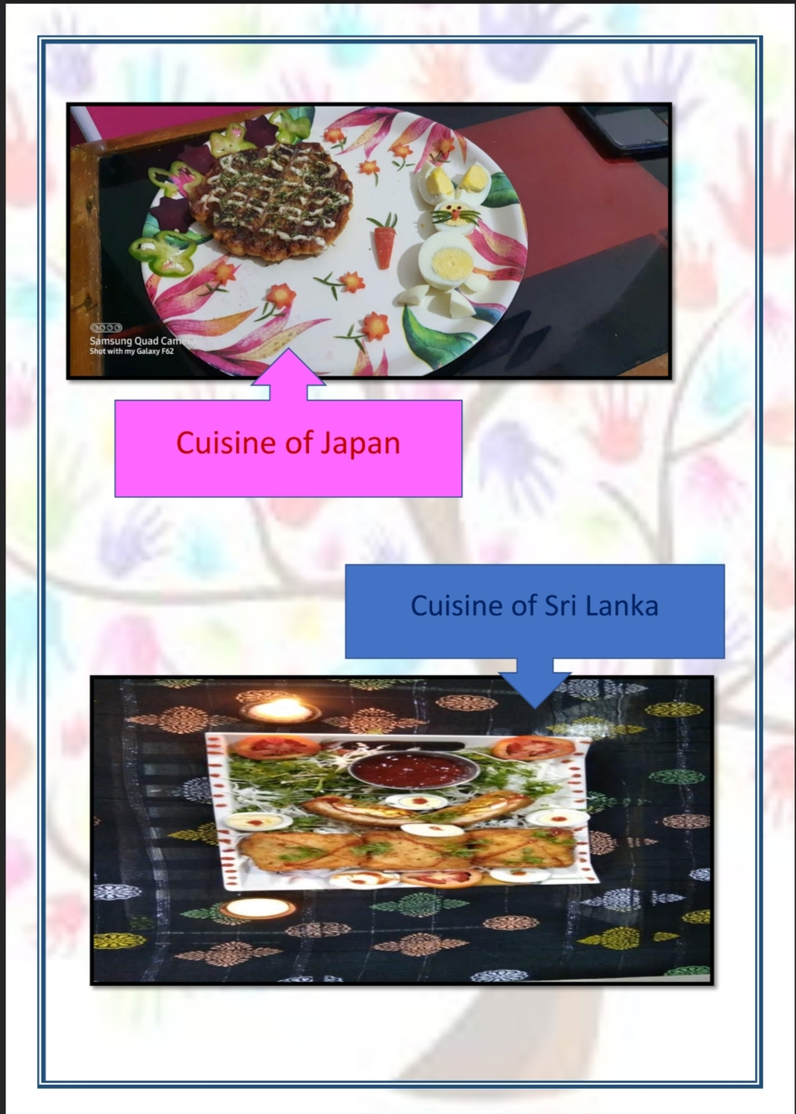

Slide 45


We won INTERNATIONAL DIMENSION IN SCHOOL AWARD In March 2022 FOR 2022-2025 By British Council under the guidance of IDS coordinators Ms. Manisha Dubey and Ms Snehal Rulekar.

Slide 46


DCP: Digital Citizenship Programme
Notes:
Trainer Notes
Digital Citizenship is a concept of using technology appropriately by teaching our students responsible, safe and ethical use of technology. Digital Citizenship Programme (DCP) is the part of academic excellence in schools. It has been accepted as a key USP for MLZS in the new TV ad. This program addresses the 21st century skills and is aligned to the ESP as well through digital media literacy. Digital Citizenship aims to teach responsible, safe and ethical use of technology.

Slide 47

Financial Literacy Programme
(FLiP)
Notes:
Trainer Notes
Financial literacy is the ability to use knowledge and skills to manage financial resources effectively for a lifetime of financial well-being. It is mainly used in connection with personal finance matters.

Slide 48

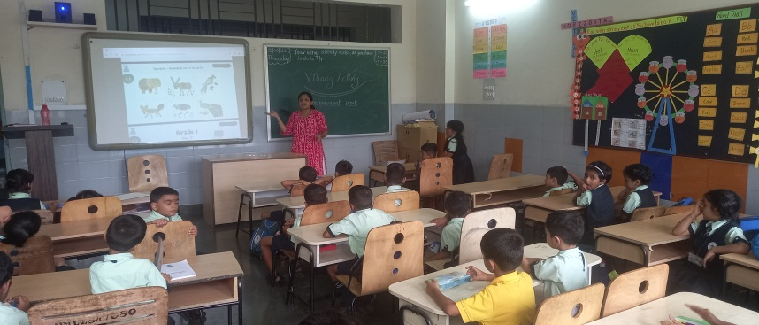
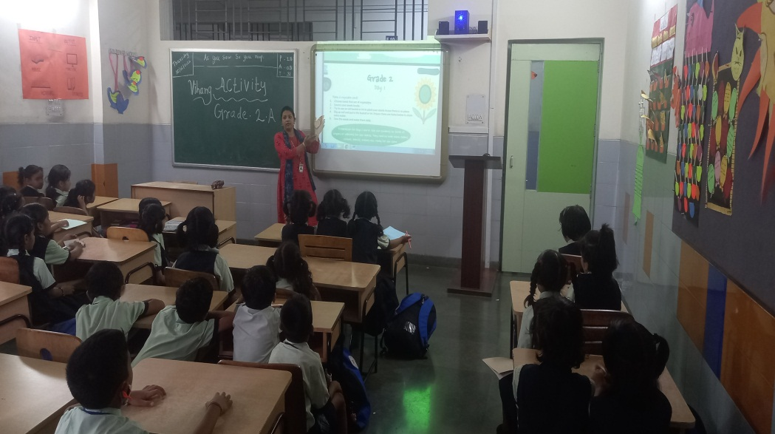
Vihaang activity
Vihaang is an activity for grade 1 to 10 based on different monthly theme subject wise.

Slide 49
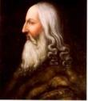

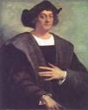

HOUSE INCHARGES
LDV: Leonardo da Vinci ( Red house)
Mr.Omkar Khonde
2. MG: Mahatma Gandhi ( Green house)
Mr.Prasad Amale
3. CC: Christopher Columbus ( Blue house)
Ms.Darshana Kuthe
4. AE: Albert Einstein ( Yellow house)
Ms.Puja Esai

Slide 50
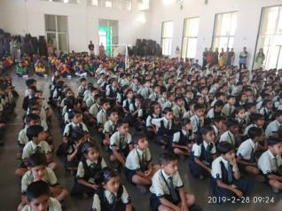
Assembly Time & Days
Students arrival: 9:00a.m.
Assembly warning bell:9:15a.m.
Objective :
1.To inculcate ethical values and discipline among the students.
2.To sensitize the students with social and emotional learning skills.
3.To start school on harmonious note.
4.To boost or enhance the confidence in public speaking and also to reduce the stage fear among the students
Days: Three Days a week.(Monday, Wednesday , Friday)
For primary.
(Tuesday , Thursday, and Saturday) for Secondary.
Mass P T: Every Wednesday for grade 1 to 5.

Slide 51
Internal and External Examination
2023-24

Slide 52
INTERNAL
EXAMINATION
2023-24

Slide 53
SCHEDULE OF EXAMINATION
EXAMINATION | Month
Periodic Test 1 | July
Half Yearly Exam | October
Periodic Test 2 | January
Yearly Exam | March

Slide 54
Assessments FOR GRADE 1To 5
Revision Days | Revision Days | Revision Days | Revision Days
1st July-7th July | 1th Oct-6 ^{th} Oct | 1st Jan- 7th Jan | 22st Feb- 28th Feb
PT-1 | PT 2/Half Yearly | PT - 3 | PT – 4/ Yearly Exam
8th July-14th July | 7th Oct. -14th Oct | 8st Jan- 19th Jan | 1th Mar Onwards

Slide 55
ASSESSMENT PATTERN
GRADES I and II
 | PT1 |  | PT2 |  | PT3 |  | PT4
Assessment | PP | NB | PP | SEA1 | PP | NB | PP | SEA2
Max Marks | 20 | 10 | 20 | 10 | 20 | 10 | 20 | 20
Scale to | 40 | 10 | 40 | 10 | 40 | 10 | 40 | 10
 | 40 | 10 | 40 | 10 | 40 | 10 | 40 | 10
GRADES III-V
 | INTERNAL |  |  | HALF YEARLY(50) | INTERNAL |  |  | YEARLY (50)
 | PT1 |  |  |  | PT2
Assessment | PP | NB | SEA1 | PP | PP | NB | SEA2 | PP
Max Marks | 20 | 10 | 20 | 50 | 20 | 10 | 20 | 50
Scale to | 20 | 10 | 20 | 50 | 20 | 10 | 20 | 50
 | 20 | 10 | 20 | 50 | 20 | 10 | 20 | 50

Slide 56
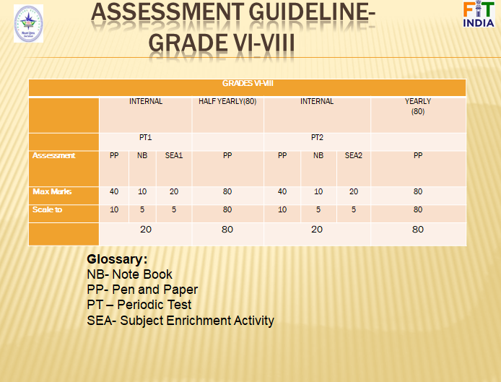

Slide 57
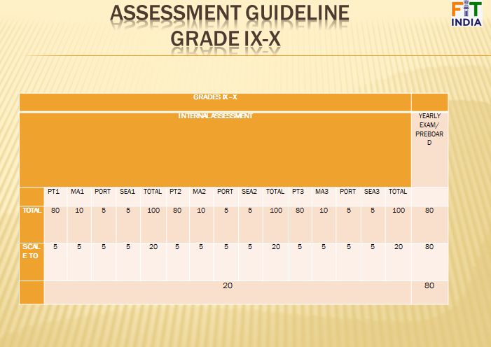

Slide 58
SCIENCE OLYMPIAD
FOUNDATION
2023-24

Slide 59
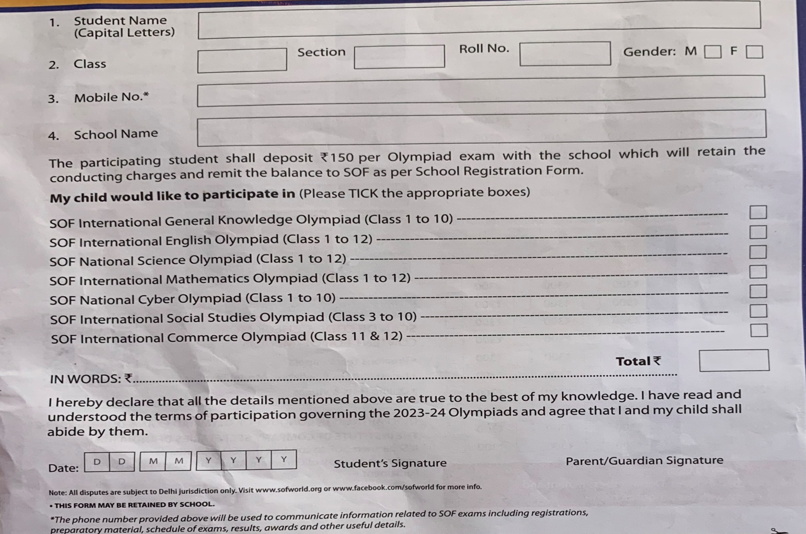
Parent’s Consent Letter

Slide 60
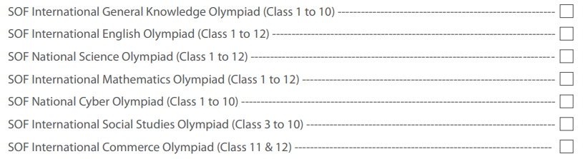

Slide 61


Slide 62

Subjects offered in classes
Subjects for I to VIII
English Language / Literature
Hindi
Marathi(Third Language)
Mathematics
Science / EVS
Library
Art and craft
Work Education
Sports
Computer / IT
GK
12. Life Skills
13. Flip
6/9/2020

Slide 63


Slide 64
IMPORTANT COMMITTEES
 | INCHARGES
EVENT & ACTIVITY | Ms. Reena Karnwal , Ms.Vaishali Gaikwad
Examination | Mr. Vyankatesh Mamdyal,Mr.Gautam Solanki
DECORATION & SOFTBOARD | Mr. Ganesh Rane
DISCIPLINE&SAFETY | Mr. Dhananjay Mahadik& Ms. Minakshi Telange
POCSO | Principal
POSH | Principal
GRIEVANCE AND REDRESSAL | Principal
ASSEMBLY | Mr. Soma Banerjee ,Ms.Roshani Barapatre
CBSE CO-ORDINATOR | Mr. Gautam Solanki
IDS ACTIVITY | Ms. Manisha Dubey

Slide 65



I-CARE
If you find bullying please contact vice principal and principal

Slide 66


i- care
SAFE AND UNSAFE TOUCH
The school will not tolerate inappropriate behaviour by students such as bullying or ragging of any kind, overt display of affection between students, theft, forgery, borrowing without permission of the owner, improper care of the property of others and using obscene or vulgar language.

Slide 67


Slide 68


Evacuation Drill (Evacuation Plan)
3 Times in a year

Slide 69


Fire Safety Drill

Slide 70



School uniform
Girls’ skirt should be up to knee length.
Boys’ shirt is required to be tucked into the pants at all times.
Girls’ shirt are to be as prescribed in the Dress Code and should be worn, extending at least 6” below the waist.
Sports uniform to be worn by all students on every Wednesday and Saturday.

Slide 71

food menu
In case your child is allergic to suggested menu, you can send suitable snack in their tiffin

Slide 72







Health And Hygiene
Here are some precautions you and your family can take to help avoid infection

Slide 73

PTA ……PTM……SMC…Parents as resources

Slide 74



School- Parent Partnership
The PTA and the PTM
If you have expertise in a specific field, an unusual hobby, or have a different culture that you would like to share, please let us know.
If your child become discouraged or fearful about school, please communicate with us so that we can discover the cause of the problem.
Teacher Meeting Schedule- As per their convenience parents can meet any teacher after school hours. In PTM they can talk to the teachers.
Principal and Vice Principal meeting schedule- Parents can meet at any time as per their convenience.

Slide 75
PTMs
PTM I – 22 July 2023
PTM II – 20 Oct 2023
PTM III – 27 Jan 2024
PTM IV – March 2024

Slide 76



Important
Parents are requested to Notify the staff of any change in their address or contact-details.

Slide 77


Important Pages In The Almanac
❖ Leave notes are must after resuming school in case of absenteeism.
❖ Kindly fill Page 1 to 4 given in the almanac. Submit to your class teachers by 30th June
❖ Parents are expected to attend the seminars & other activities arranged by
the school

Slide 78



Parent Involvement
You are the key to your child’s success. Parents and teachers play an
active role in a child's
education…
Together,
we help them reach their full potential.

Slide 79


Slide 80
New PROPOSAL OF SESSION 2023-24
Reporting Time:9:00 a.m. sharp.
Dispersal Time:3:10p.m. sharp.
Every 2nd and 4th Saturdays are working for all students attending school is mandatory.
Co-Curricular Activities will be conducted on 2nd and 4^{th.} Saturdays
Students have to wear House Uniform on Wednesday and Saturday.
This Academic year we will have Grand Annual Sports Day in the Month of December.

Slide 81
Mode of Fee Payment
Payments can be made in school through
Debit Cards
Credit Cards
UPI
Net Banking.

Slide 82



BIRTHDAY POLICY
(Primary section)
The Students can bring sapling of plant or donate a book to Library instead of chocolates.
No Birthday Parties Will Be Held In
School
No Birthday Gifts or Return Gifts Will Be
Exchanged With Students or Educators.
You can Send your child in party dress.
A small sapling can be planted by the child.

Slide 83
Health Issues
In some cases, if the medical attention is required
specially please keep the authorities of the school
informed at all times with doctor’s prescription
attached.
No student should attend school if he/she is
suffering with serious or contagious disease. They
will be allowed to attend the school again when a
medical certificate is produced.

Slide 84
Areas of observation
• Personal Hygiene
• General behavior of the students
• Discipline of the students
• Punctuality of the students
• Academic Records
• Active Participation of the students in different
activities
• Absenteeism
• Overall Personality Development

Slide 85

Some incentives subject-wise
I am Jmlzs scientist
BADGES will be provided for specific subject by HODS,PRINCIPAL AND VICE PRINCIPAL for motivation

Slide 86




Some incentives subject-wise
Attendance
I am mathematician

Slide 87
Transport Policy
Student should arrive at assigned bus stop five minutes ahead of the bus. The driver cannot wait for you, as it may create traffic problems.
The bus attendant has the authority to assign seats.
Parents are not allowed to interfere about their children's seats because teachers have given the right to arrange children's sitting and they can rotate kids on a monthly or weekly basis.
Students are required to ride their assigned bus, unless they have written approval from the transport department.
In some cases if parents come & pickup their kid then prior notice must be given to teacher regarding the take away.
If your are a walker & because of some reason if you cannot come to school for takeaway your kid than you must handover written letter to the person whom you trust and want to handover your kid. Otherwise we will not allowed your kid to go with any one if you call us and insist us.
Refrain from talking to the driver expect in an emergency.
Parents should also support policies of the school and transport department.
Students are not allowed to eat in bus as it can harm them while travelling eating is dangerous.
© Jindal Mount Litera Zee School, Sukeli.

Slide 88
BUS ROUTE
Bus NO. | Route Name | PhoneNo. | Driver and helper name
1 | Pali-1 Pali-2 Pali-3 | 8087440410 8793235860 9011814001 | BhaskarDalvi Aslam Zamadar Jitu Nate
2 | ROHA | 9910880731 | Mr. Mahesh Tawale(Driver)
3 | KOLAD | 7798704357 7757972790 | Mr Suhas Pawar(Driver) Mr. Milind Lahane
4 | Khamb | 9730018789 9270141116 | Mr.Nilesh Chingade
5 | Mangaon-Indapur | 9225488640 | Mr. Nandakumar Vani(Driver)
6 7 | VILE Nagothane | 7498854213 9422351104 9422351104 9545754524 9021603966 | Mr.Ketan Wani RiceMill Lake View SBI Amdoshi

Slide 89






Parent Communication
Students Handbook / Almanac- will provide valuable information regarding School procedures.
Academic Calendar- will be uploaded on the school website and soft copy will be provided to parents on their wards class group.
Web Site http://www.jmlzsnagothane.edu.in/- The school website will have information regarding and will be updated on a consistent basis.
https://www.facebook.com/jmlzsnagothane
E-mail:- jmlzsnagothane@gmail.com
Phone calls:-02194 238845, 9422351104
Circulars:- Written circulars will be sent to the parents whenever required.
School management system:- It is available on school website.

Slide 90
Our consultation Timings
Time to meet Principal : 2:00 p.m. to 5:00 p.m. (Monday - Friday)
(with prior appointments only)
Time to meet Teachers :Only on Saturday
(with prior appointments only)
Office timings : 09:00 a.m. to 05:00 p.m. (Monday to Friday)
      : 9.30 a.m. to 3.30 p.m. (Saturday)
Note:(meeting with prior appointments only, Appointments can be taken through a note in almanac or by a phone call to principal or vice principal)

Slide 91


Slide 92


