Slide 1
A Warm Welcome to all Parents
and Guests!!
2021-22
Middle,Secondary and Senior Secondary section

Slide 2
The vision of Mount Litera Zee School envisages:
To create an excellent educational institution synthesizing the human values with the highest quality of teaching–learning using modern technology-driven tools for preparing a well- rounded personality for our society.
To shape global minds on the Indian soil.
To ensure this, the school will give every student an access to world-class infrastructure, and an innovative curriculum that promotes the all- round development of the child imbibing traditional values.
3

Slide 3
Our Core Values
At the core of every thing we do at Mount Litera Zee School is one simple principle. What’s Right For the Child (WRFC). Through that mantra we filter all our decisions and actions. WRFC helps us keep the child at the centre of everything we do and ensures single- minded devotion to her growth and development.

Slide 4
LET’S INTRODUCE YOU TO THE MANAGEMENT COMMITTEE

Slide 5
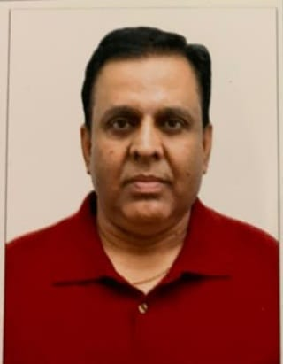
School Management Committee Members
Member
Mr. Sanjeev Banerjee
Member
Mr. Shivkumar Singhal
Chairman
Mr. Vijay Kaushik

Slide 6
OUR MENTOR
REGIONAL SCHOOL DIRECTOR
Ms. Anshul Saxena
Contact No:- 86577 35898
Email ID:- anshu.saxena@zeelearn.com

Slide 7
VICE-PRINCIPAL OF THE SCHOOL
PRINCIPAL OF THE SCHOOL
Ms. Savita Sharma Contact No:- 7875092867
EmailID:mlzsnagothane@gmail.com
Ms. Bijal Awasthi Contact No:- 9016193906
Email ID:- vpjmlzs@gmail.com

Slide 8
FOR YOUR REFERENCE
Sr. Executive (HR & Admin)
Mr. Ajay Yadav
Contact No:- 9422351104 Email ID:- yadavajay.jmlzs@gmail.com

Slide 9
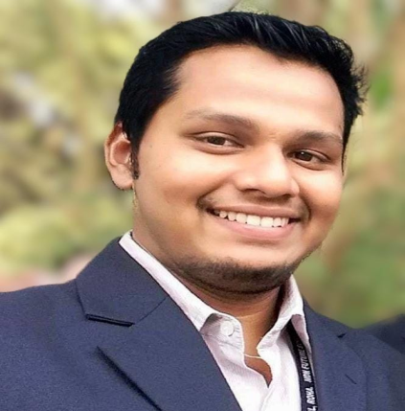
Relationship Manager Ms. Vishwakala Nair Contact No:- 8007077936 Email ID:- Vsnair.jmlzs@gmail.com
I.T. Head
Mr. Pratik Palande Contact No:- 75584 98598 Email ID:- jmlzsit@gmail.com
Accounts Officer
Mr. Devender Kashyap Contact No:- 9358395658
Email ID:- kashyap.jindal@gmail. com

Slide 10
Infrastructure
PLAYGROUND
AUDITORIUM
COMPUTER LAB
LIBRARY
MUSIC ROOM
ART ROOM

Slide 11
LANGUAGE LAB
DANCE ROOM
SPORTS ROOM
CONFERENCE ROOM

Slide 12
PHYSICS LAB
CHEMISTRY LAB
BIOLOGY LAB
MATH LAB

Slide 13
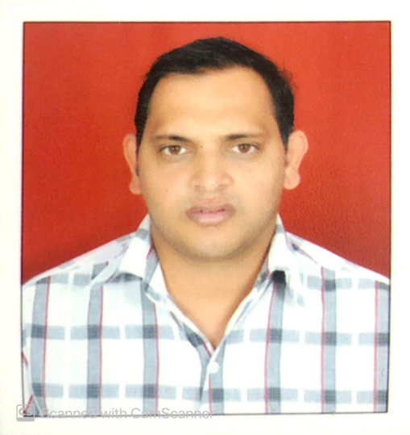
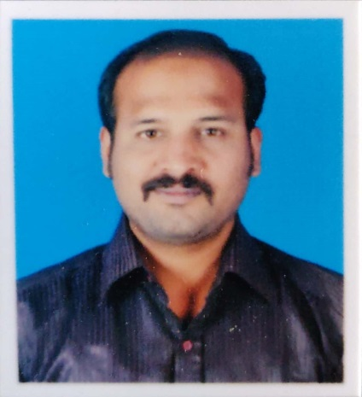
Mr. Tejas Jagle TGT English
Mr. Lavkesh Landge
Mrs. Snehal Rulekar (TGT English)
(PGT English & HOD)
Mr. Avadhut Atahvle
HOD (Computer Science)
Mrs. Puja Esai (PGT Math & HOD)
Mr. Gautam Solanki
(TGT Math)

Slide 14
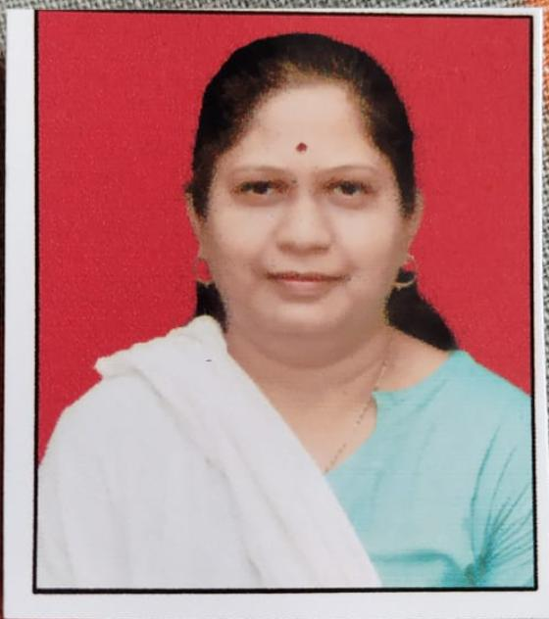
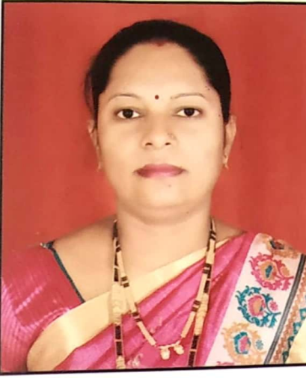
Mrs. Manisha Dubey TGT (Science)
Mr. Omkar Khonde (PGT Chemistry)
Ms. Rekha Khairnar PGT Physics
Mr. Gajanan Awsarmol TGT (Social Science)
Mrs. TGT (Social Science)
Mrs. Darshana Kuthe TGT(Hindi) & HOD

Slide 15
Ms. Sunita Binedar
HOD Marathi
Ms. Mamta Mane
Librarian
Mr. Pratik Nikam Music Teacher
Mr. Rahul Savtirkar Dance Teacher
Mr. Dhananjay Mahadik Sports Teacher
Mr. Ganesh Rane Art Teacher

Slide 16
School Timing
Monday to Saturday: 03:00p.m..– 8:40 p.m.
Attending school on Second and Fourth saturdays is mandatory.
First and Third Saturday will be off for students.
School Office Timing on all working Days 9:00 a.m. to 5:00 p.m.
Timing during Long vacation 9:30 a.m. to 3:30 p.m.
School Office will be open on all Saturdays except Gazetted Holidays.
Parent can meet Principal and Vice-Principal on all working days (2:00 p.m. to 5:00 p.m.) with prior appointment.
Parent can meet the Class teachers and Subject teachers on all Saturdays except Third saturday between 10:00a.m. to 12:00 noon with prior appointment

Slide 17
Our Vendors
School Uniform: Amardeep school Uniform junction,Bazarpeth, Roha, Maharashtra 402109. Ph.No. 02194-234858/9890405600
Notebooks & Stationery: Mr. Amit Agrawal (Agrawal store) Ph.No. 02194-222063/9822892003
Bus Vendor:Raj Tours & Travels
(Mr. Rajesh Rathod Ph.No.9225515415/9028635337)
Bus Vendor:Sooraj Tours & Travels
(Mr. Suraj Dhope Ph.No. 8408813132/9272867558)

Slide 18
HOUSES There are 4 houses in JMLZS
LDV: Leonardo da Vinci ( Red house)
MG: Mahatma Gandhi ( Green house)
CC: Christopher Columbus ( Blue house)
AE: Albert Einstein ( Yellow house)

Slide 19
HOUSE INCHARGES
LDV:( Red house) Ms. Rekha Khairnar
MG:( Green house) Mr. Gajanan Awasarmol
CC: ( Blue house) Ms. Gangotri Mishra
AE: ( Yellow house) Ms. Manisha Dubey

Slide 20
CLUBS
Sr No. | Club Name | Club Incharge
1 | Art Club | Mr. Ganesh Rane
2 | Music Club | Mr. Pratik Nikam
3 | English Literary Club | Ms. Snehal Rulekar
5 | Science Club | Mr. Omkar Konde
6 | Heritage Club | Mr.Gajana Awasarmol & Ms. Shreya Khot
7 | Raigad Club | Mr. Dhananjay Mahadik
8 9 | Math Club Design For Change | Ms. Puja Esai

Slide 21
BIRTHDAY POLICY (Secondary & Sr. Secondary)
The child may distribute a chocolate not exceeding Rs.5/-
No birthday parties of students or educators will be held in the class.
No return gifts & birthday gift will be exchanged between the Educators & the students in the class.
Students should wear school Uniform with school ID.
Note : No parent will exchange any gift or favours from any of the educators and authorities of the school.

Slide 22
Health Issues

Slide 23
Areas of observation
Personal Hygiene
General behaviour of the students
Discipline of the students
Punctuality of the students
Academic Records
Active Participation of the students in different activities
Absenteeism
Overall Personality Development
25

Slide 24
Hierarchy to be followed for giving feedback/resolving grievance
(for any queries, suggestions, feedbacks kindly follow the hierarchy)
The complaint can be in the mode of e-mail and in written mode between 10.00 a.m. to 1.00 p.m. (Monday to Friday only) Ph. No. 02194-238845, 9422351104,9016193906
email-id:mlzsnagothane@gmail.com
The Class teacher will maintain the record of the query made and convey it to the concerned authority on the same day. The Class teacher will be responsible for taking the feedback and the proper closure from the concerned authority and will give a proper closure to the parent within 3 days. The parents will contact the Principal for any queries. If the query is not closed within 3 days then it will be escalated to the Regional school Director.
Class teacher
HODs
Principal
RSD

Slide 25
ELearning Platforms for Students
E-Learning platform is available for the students of Classes I to VII
Students can download the Innova Elearning App from Google Play Store.
School has provided each student with unique User ID & Password.
Students have to enter the given User ID & Password and access the content.
http://diksha.gov.in http://epathshala.gov.in http://nroer.gov.in/welcome http://Swayam.gov.in
National Digital Library-
http://ndl.iitkgp.ac.in

Slide 26
E-Learning- Virtual Class & Etiquettes
Availibility of technological infrastructure- Smartphones,Tabs, Laptops, Wi-fi/broadband connection or proper internet service.
Regular attendance to the online lectures.
Keep Video on during online lecture.
Keep your voice muted.
Ask your queries through chatbox.
Parents should keep on checking while the child is attending online lectures.
6/9/2020

Slide 27
THE LITERATI
If you’re following us on social media or frequently visiting our website, you may already be in-the-know about all things MLZS. We also know it’s easy for information to fall through the cracks in these ‘blink-and-you-miss-it’ times. As such, we’re introducing a monthly newsletter titled “THE LITERATI” to share with our students and parents the most relevant information in one place, once monthly.
Happy Reading!!

Slide 28
Where can we find “The Literati”

Slide 29
THE LITERATI

Slide 30
6/9/2020

Slide 31
6/9/2020

Slide 32
6/9/2020

Slide 33
Online classes will be conducted from 3:00 p.m. to 8:40 p.m. as per schedule.
6/9/2020

Slide 34
Assessment Guideline- Grade VI-VIII
 | Term 1 (100) |  |  |  | Term 2 (100)
 | Internal Assessment (20) |  |  | Half Yearly Exam (80) | Internal Assessment (20) |  |  | Yearly Exam (80)
Assessment | SEA 1 | Periodic Test 1 | Notebook | Half Yearly Exam | SEA 2 | Periodic Test 2 | Notebook | Yearly Exam
Total Marks | 10 | 40 | 20 | 80 | 20 | 40 | 10 | 80
Scale to | 5 | 10 | 5 | 80 | 5 | 10 | 5 | 80
Break Up | 20 |  |  | 80 | 20 |  |  | 80
 | July | Aug | Sep | Nov | Jan | Jan - Feb | Feb | April
[SEA 1 scores for all subjects are mapped to the rubric used. Hence the marks for each subject varies from 10 – 20, but these are all scaled down to 5, as mentioned in the table above.
For grades 6 to 8, CBSE Academic circular 14/2017 dated 21/03/17 has been followed.]

Slide 35
Assessment Guideline- Grade IX-X
6/9/2020

Slide 36
Examination and Evaluation System (Secondary :VI to X)
Assessment Schedule- Grades VI - X
Grades VI to VIII
Grades IX and X: April Centers

Slide 37
Subjects offered in classes
Subjects for VI to VIII
English Language / Literature
Hindi
Marathi(Third Language)
Mathematics
Science / EVS
Library
Art and craft
Work Education
Sports
Computer / IT
GK
12. Life Skills
6/9/2020

Slide 38
Subjects Offered in Classes IX-X
SUBJECTS | SUBJECT CODE
English language/Literature | (184)
Mathematics (STANDARD) | (041)
Hindi | (085)
Science | (086)
Social Science | (087)
Information Technology | (402)
SR.NO | SKILL SUBJECT
1 | Library
2 | Work Education
3 | Sports
4 | Life Skills

Slide 39
Subjects Offered in Classes XI & XII
SUBJECT | SUBJECT CODE
English Core | (301)
Mathematics | (041)
Biology | (044)
Physics | (042)
Chemistry | (043)
Information Technology | (402)
SR.NO | SKILL SUBJECT
1 | Library
2 | Work Education
3 | Sports
4 | Life Skills

Slide 40
Grade – VI to VIII
Row Labels | Quantity
Art book A3 - 40 pages | 1
Graph Book, 56 Pages | 1
Single lined, 96 pages | 12
Four line notebook (40 Pages) | 1
Single line long register (200 Pages) | 3
6/9/2020

Slide 41
http://jmlzsnagothane.edu.in/calendar.aspx
Annual Academic Calendar 2021-22

Slide 42
Our School Program During Regular School
Children need to attend a full day of school each day.
Regular attendance is expected.
The reporting time to school is 9:00 a.m. and the assembly starts at 9.10 a.m. sharp.
Following an absence, the parent must send a written note stating the reason for the absence.
Students will NOT be sent home early under any circumstances except any emergency. In case a child is not well, kindly do not send him/ her to school.

Slide 43
MONTHLY THEMES FOR 2021-22
April 2021 Theme – Reading
June 2021 Theme – Linguistic
July 2021 Theme – Mathomania
August & September 2021 Theme - Tranquility
October & November2021 Theme -Celebration

Slide 44
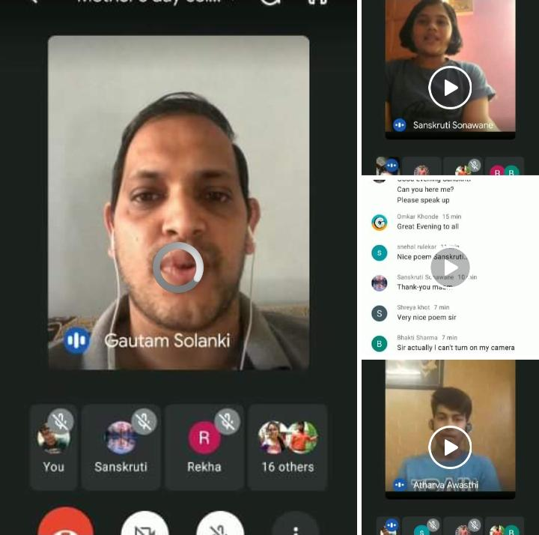
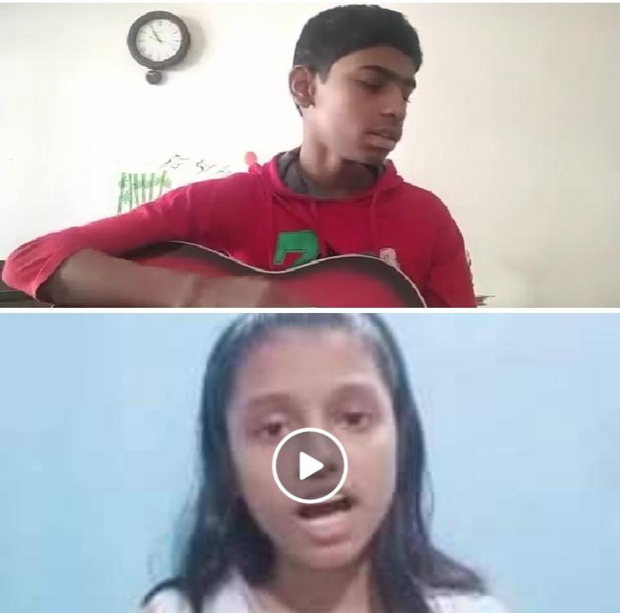
Virtual School Activity
World Book Day
Christmas Celebration
Mother‘s Day Celebration

Slide 45
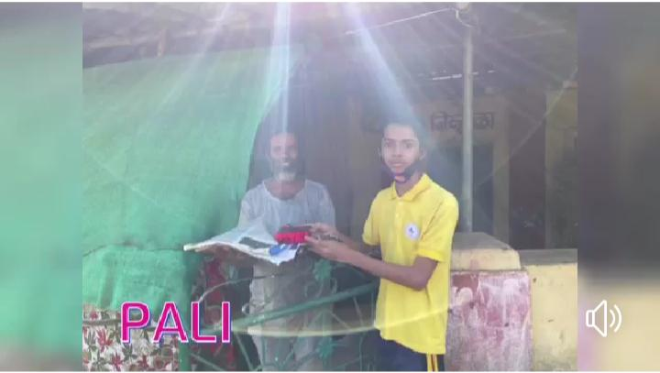
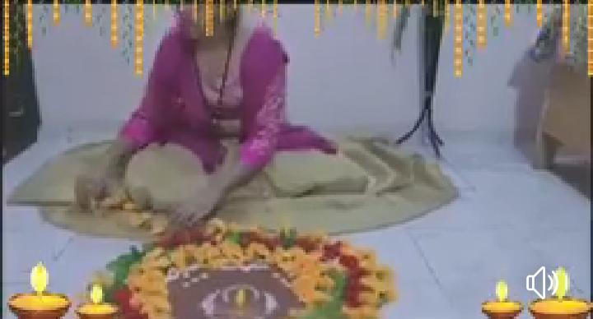
Virtual School Activity
Diwali Celebration
Navratri Celebration
Children‘s Day Celebration

Slide 46
I-Care & POCSO
Proection of Children from Sexual Offences Act 2012 (32 of 2012)
Sexual offences committed by the persons who are in the ownership, management of staff of educational institutions and persons in position of Trust and Authority over children are liable for higher punishment as per the provision of sections 5,6,9 and 10 of the Act.
A case lodged under the Act is non-bailable.

Slide 47
Parent Communication
Students Handbook / Almanac- will provide valuable information regarding School procedures.
Academic Calendar- will be uploaded on the school website or provided in paper format, to parents and will focus on information regarding your child’s upcoming activities & holidays.
Web Site http://www.jmlzsnagothane.edu.in/- The school website will have information regarding the and will be updated on a consistent basis.
https://www.facebook.com/jmlzsnagothane
E-mail:- mlzsnagothane@gmail.com
Phone calls:-02194-238845, 9422351104
Circulars:- Written circulars will be sent to the parents whenever required. It will be available on school website.
School management system:- It is available on school website.

Slide 48
Education + APP

Slide 49
ALMANAC

Slide 50
Guidelines for Parents...
Parents form a vital part of the school curriculum and hence they are expected to abide by a certain set of rules.
Parents are requested to read the rules and regulations mentioned in the Almanac.
School Almanac must be checked daily for any communication and signed by the parent.
Written information must be given to the school for any allergies/ regular medication
Any change in address or contact number must be informed in written via mail or letter addressed to the Principal within 2 days.
Parents can meet teachers on 3rd Saturday only.
At least 75% attendance is compulsory for students.
Regarding any problem related to corrections in LR and notebooks , parents can write note in the almanac and call in office or to the principal.
Almanac Pg. No. 4 & 5 must be filled with the photographs.
jmlzsnagothane@gmail.com

Slide 51
Parent Involvement
You are the key to your child’s success. Parents and teachers play an active role in a child's education…
Together,
we help them reach their full potential.

Slide 52
Parents On Campus Policy
We strongly believe that Holistic Development of students is based on 4 pillars Student, Parent, Teacher and School.
To further strengthen the bond of all stake holders, we hereby, introduce the “Parent On Campus” policy.
In short, Everyday one parent present in the school campus before the start of the school till the end of the school.
This will not only enhance the trust between parents and school but will prove to be an important step towards fostering a relationship of confidence.
This is an effort to supplement and re-enforce our commitment to provide Safe and Secure Environment and to make parents as Partners in our endeavor of imparting Holistic Quality Education.

Slide 54
School- Parent Partnership
The PTA and the PTM
If you have expertise in a specific field, an unusual hobby, or have a different culture that you would like to share, please let us know.
Should your child become discouraged or fearful about school, please communicate with us so that we can discover the cause of the problem.
Teacher Meeting Schedule- As per their convenience parents can meet any teacher after school hours. In PTM they can talk to the teachers.

Slide 55
PTMs
PTM I – 19 June 2021
PTM II – 24 July 2021
PTM III – 23 October 2021
PTM IV – 11 December 2021
PTM V – 15 January 2022

Slide 56
PTA
The greatest benefits associated is that it helps teachers to understand students from the parent’s perspective and vice versa. It helps parents to know all about the functioning of the school, problems and so on. It works towards making the school better and the best place to get a quality education. In this, it is the teachers and the parents that sit together and discuss various issues regarding school and even a particular student. The overall aim of the PTA meeting is to ensure the school offers the best learning experience for the students keeping in mind their needs.
PTA I – 24 July 2021
PTA II – 23 October 2021
PTA III – 15 January 2022

Slide 57
Mode of Fee Payment
Now Parents can pay school fees via online mode of transaction through school website through the link given below-
http://www.jmlzsnagothane.edu.in/OnlineFeePayments.aspx
OR
Through new Eplus Android Mobile App
https://play.google.com/store/apps/details?id=com.innova.studentsnagothane&hl=en
( Login ID and Password is sent to parents on their registered mobile number with school)
OR
Payments can be made in school through Debit Cards/ Credit Cards and Net Banking.
6/9/2020

Slide 58
Important
Parents are requested to Notify the staff of any change in their address or contact-details.

Slide 59
Written information must be given to the school for any allergies/ regular medication

Slide 60
HOMEWORK
Minimum 3 subjects homework will be given to students.
Math homework will be given daily.
Student must do homework as it helps them to understand the subject matter taught.
During absence student can check homework given by teacher by logging-on E-plus Mobile App.

